Slide 1
ITCS 6166 - Computer Comm & Networks 3d Human Modeling
Group 8
Praneeth Reddy Kanchanakuntla
Akhil Chala
Kousik Varma Dandu
Durga Sri Jonnalagada

Slide 2
Overview
Introduction
Applications
Requirements
Media pipe and it’s Application
Proposed architecture
Output
Problems Faced
Conclusion

Slide 3
Introduction
Three-dimensional (3D) human modeling involves the creation of virtual representations of the human body using computer software. It has numerous applications in various industries, including entertainment, medical research, and fashion design.
In the entertainment industry, 3D models are widely used in video game and film production to create realistic and lifelike characters that can interact with the digital world. In medical research, 3D models enable researchers to gain a better understanding of how the human body works and how diseases can impact different systems.

Slide 4
Applications
3-D human models can be used for a variety of purposes, including:
➔Video game development: 3D human models are used in video games to create lifelike and realistic characters.
➔ Film and animation: 3D human models are used in film and animation to create lifelike characters and visual effects.
➔Medical research: 3D human models are used in medical research to study human anatomy and develop new treatments and surgical procedures.
➔Fashion design: 3D human models are used in fashion design to create virtual clothing designs and to visualize how garments will look on human figures.

Slide 5
Hard ware and Software Requirements
Software Requirements:
1. Mini Conda
2. VS Code
3. Cuda Nivida Tool kit
Hardware Requirements
64-bit Windows or Mac
Greater than 8-gb ram
GPU

Slide 6
Media pipe
Media pipe is an open-source framework developed by Google that provides a set of pre-built tools and algorithms for building real-time computer vision applications. One of the components of Media pipe is a 3D human pose estimation module that can be used to create 3D models of human figures.
Using Media pipe for 3D human modeling involves the following steps:
1. Capturing video data or getting video: A camera is used to capture video footage of a human subject. The video footage is then fed into the Media pipe framework.
2. Processing video data: Media Pipe’s human pose estimation module analyzes the video footage to estimate the 3D pose of the subject.
3. Building the 3D model: Once the pose is estimated, a model of the human subject can be created using the estimated pose data. This can be done using a variety of 3D modeling software tools.

Slide 7
Blaze pose -> Pose estimation
Blaze Pose is a pose detection model developed by Google that can estimate the 2D and 3D poses of a human body in real time.
The landmark points in Blaze Pose are pre-defined and correspond to specific parts of the body, such as the shoulders, elbows, wrists, hips, knees, and ankles. The model uses these landmark points to estimate the 2D or 3D position of each joint and the overall pose of the body.
There are around 33 key landmarks for the blaze pose.

Slide 8
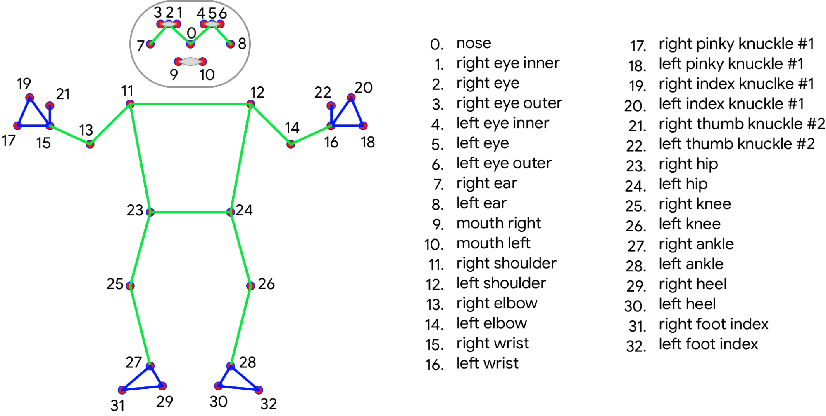
Blaze pose – landmarks

Slide 9
Execution – Project Plan of Action
The aim of the project is to develop a 3d human model which accepts the user’s input and transforms the user input to a 3d animated model which corresponds to the user input and should be deployed on the web etc.
For making the above possible we have two models
1. app.py → file which accepts the user’s video input in Streamlit and transforms the input to landmark skeleton video using media pipe
2. demo.py → file which uses “VIBE” for converting the input into a 3d Human model

Slide 10
Proposed Model Architecture
User Input from Streamlit
Mediapipe 2d landmark detection
Get in 3d
Display the result in streamlit

Slide 11
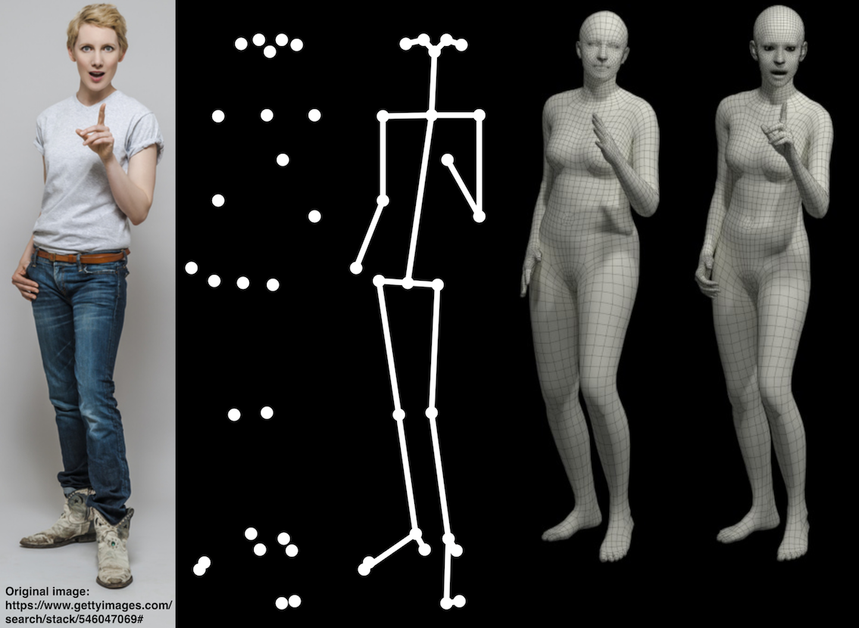
A sequence of Output
User Input
Stream of landmarks from media pipe
The output achieved in the app.py
The refined input
The output achieved in demo.py

Slide 12

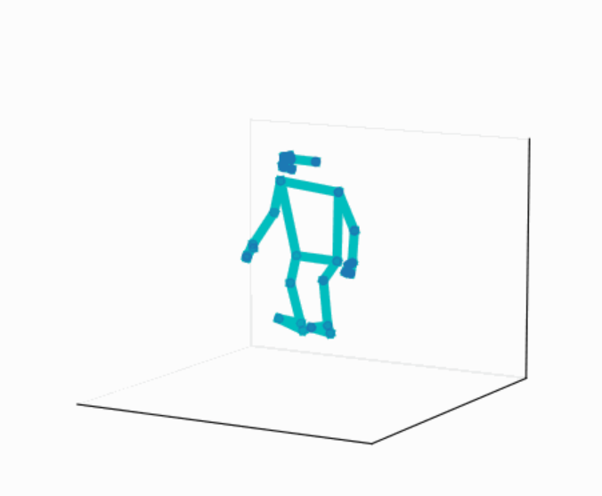
Output of app.py

Slide 13
VIBE: Video Inference for Human Body Pose and Shape Estimation
We acknowledge the contribution of the authors of papers Muhammed Kocabas; Nikos Athanasiou; Michael J. Black and their open-source work.
VIBE uses CNNs to extract image features. The output from the CNN is fed as input to the recurrent neural network, which processes the sequential nature of human motion.
VIBE leverages a combination of 2D and 3D convolutional neural networks (CNNs) to estimate the pose and shape of a human body in a video. It consists of two main components: a pose estimator and a shape estimator.
The VIBE model has been shown to achieve state-of-the-art performance on several benchmark datasets for human body pose and shape estimation, including Human3.6M, MPI-INF-3DHP, and AMASS. The model has applications in a variety of fields, including computer graphics, virtual reality, and human-computer interaction.

Slide 14
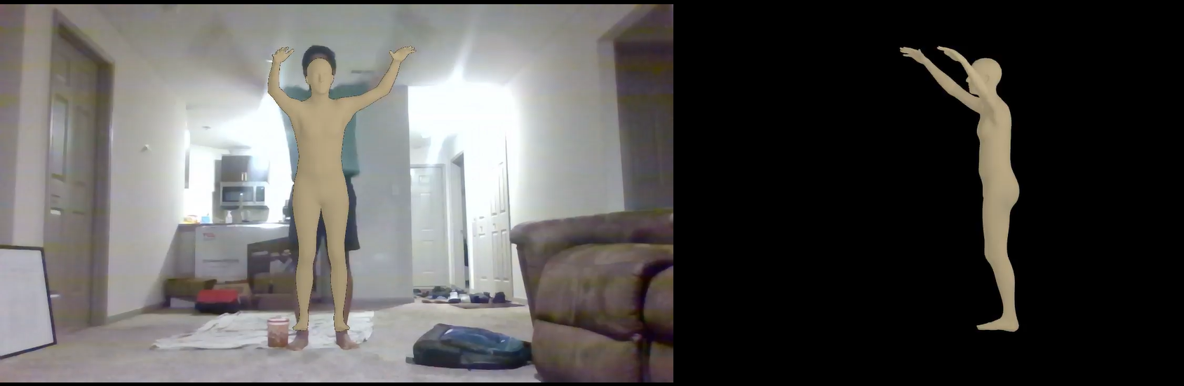
Output of demo.py

Slide 15
Problem Faced
We are unable to deploy the application because the model requires
huge computational power which it is not possible in streamlit cloud.
->The app.py, displays the output in streamlit, google collab in capacity to achieve the web app.
-> third-party software can be used to model into 3d humans such as Blender, Unity, or Maya.

Slide 16
Conclusion
1. we are able to achieve the aim of modeling the 3d human by using demo.py using the vibe module
2. we are able to obtain the landmarks from the video and display the output.

Slide 17
Thank you

